Slide 1
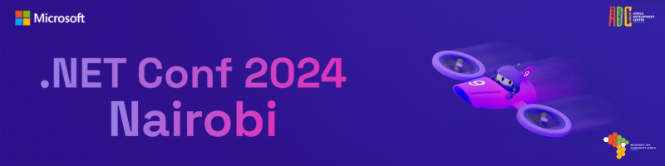


Minimal APIs
Winfred Kilonzo
@WinfredKilonzoN
Winfred Kilonzo

Slide 2
Approaches to Creating APIs
Controller-Based Approach
Minimal APIs
Notes:
Controller-Based Approach:
This is the traditional method for creating APIs in ASP.NET Core. It uses controllers, actions, and attributes, offering a structured, feature-rich approach.
Minimal APIs:
Introduced in .NET 6, this approach is a lightweight, simplified alternative. Minimal APIs focus on reducing boilerplate code and enabling quick development.
Why do we need Minimal APIs when we already have robust controller-based APIs with attributes and built-in features?
Why are we getting empty templates?

Slide 3
Why Minimal API?
Simplifies setup and reduces boilerplate code
Consume less memory
Focuses on core functionality rather than structure.
Lowers the learning curve for non-.NET developers.
APIs don’t inherently require MVC structure.
Performance benefits: Less overhead compared to controllers.
Continual addition of new features.
Minimal APIs don't have to be located in Program.cs.
Notes:
For Non-.NET Developers:
Developers from non-.NET ecosystems, such as Node.js or Python, they might not be aware of what are controllers and their naming conventions. It will require them to learn dotnet fundamentals hence they won't get the API running quickly. Minimal APIs simplify the experience, letting them jump straight into building APIs without needing to grasp advanced .NET patterns.
Historical Context:
Controllers originate from the MVC architecture, which was initially designed for building web applications. Microsoft unified APIs with the MVC pattern for consistency, but APIs themselves don’t inherently need that structure. Minimal APIs acknowledge this, providing a simpler and more direct approach.
Simplification:
The focus of Minimal APIs is on simplicity. The straightforward approach makes the development process more efficient and less intimidating for new and experienced developers alike.
Performance Benefits:
Minimal APIs strip away unnecessary features like controllers, reducing overhead and improving runtime performance.
Future Potential:
Microsoft is continuously enhancing Minimal APIs with new features, ensuring they remain relevant and competitive for modern API development. Only a few features are missing such as model state validation

Slide 4
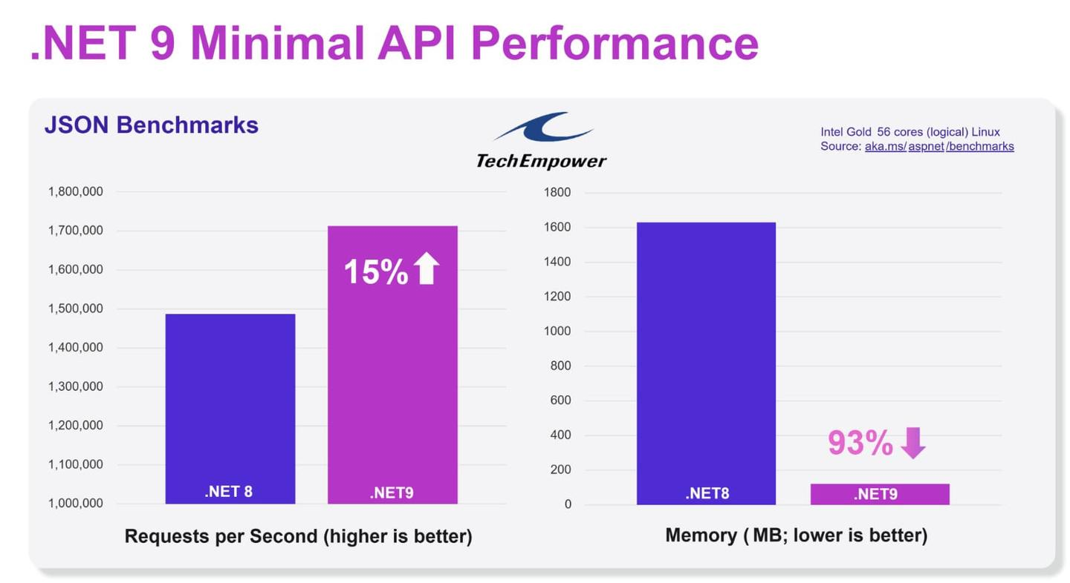

Slide 5
Controller-BASED API vs. Minimal API
Minimal API
Defined in Programs.cs
Simple, direct and concise
dotnet new web -o MinimalApiDemo -f net9.0
Controller-Based API
Controllers, Actions, Models, and more.
Verbose setup.
dotnet new webapi -o RegularApiDemo -f net9.0
Notes:
Compare the files and folders for both project. Include swagger documentation in the next slide and run the project
Both projects contain properties folder with launch settings.json - specifies the URL and port number.

Slide 6
Documenting API’s
Swagger not included by default in .NET 9
Manual setup required for API documentation.
dotnet add package Swashbuckle.AspNetCore
Notes:
builder.Services.AddEndpointsApiExplorer(); //Generates OpenAPI metadata for APIs.
builder.Services.AddSwaggerGen(); // Adds support for creating and displaying Swagger documentation.
if (app.Environment.IsDevelopment())
{
app.UseSwagger();
app.UseSwaggerUI();
}
Add swagger and highlight that there is no difference in the API

Slide 7
Route Handlers in Minimal APIs
What are Route Handlers?
Methods or delegates executed when a route matches an HTTP request.
Define how the application responds to HTTP verbs
Supported Delegate Arguments:
Lambdas, Local Functions, Instance Methods, or Static Methods(Explored when looking at endpoints outside programs.cs).
Can be synchronous or asynchronous.
Notes:
Lambda Expression Route Handlers
Definition:
Inline or pre-declared lambda functions passed directly to route mappings.
/ Inline Lambda
app.MapGet("/inline", () => "This is an inline lambda");
// Lambda Variable
var handler = () => "This is a lambda variable";
app.MapGet("/", handler);
Use Case:
Best for simple, single-line logic without complex operations.
Local Function Route Handlers
Definition:
Functions defined within the same scope where they are used.
string LocalFunction() => "This is a local function";
app.MapGet("/", LocalFunction);
Instance Method Route Handlers
Definition:
Methods on instantiated objects that handle routes.

Slide 8
Route Parameter in Minimal APIs
Route parameters allow capturing dynamic values directly from the URL.
The parameters are then passed to the route handler in a type-safe manner.
Route handler declares expected parameter type and ASP.NET automatically parses the value and binds it to the method signature

Slide 9
Route Parameter with a constraint
Validates the route parameter before the method executes.
Constraints can include int, guid, bool, minlength, maxlength, range, etc.
Simple to use and integrated directly into routing.
Explicit routing definitions
Better error handling and validation

Slide 10
Parameter Binding in Minimal API’s
The process of converting request data into strongly typed parameters for route handlers.
Binding Sources:
Route Values - Parameters inferred directly from the route template.
Query String- Parameters extracted from the query string.
Header - Values from HTTP headers.
Body (as JSON) - Bind complex types from the request body.
Services (via DI)- Automatically inject services from the DI container.
Custom Binding

Slide 11
Organizing Minimal APIs
The Misconception
“Minimal APIs are not for production”
Most examples keep all route definitions inline or use lambda functions in programs.cs
The Challenge
Inline endpoints in programs.cs become unmanageable in large applications
It makes the code harder to maintain, extend, and test
The Solution: Use Extension Methods
Create a class file ( {Model}sEndpoints.cs).
Move endpoint definitions to separate files.
Keep Program.cs focused on high-level configuration
Notes:
In a folder called Endpoints or in a {Model} folder if you do clean architecture Flask often organizes routes in blueprints or separate modules.
Separate domain logic from route handlers (use services or repositories).
Follow naming conventions for extension methods (e.g., Map{Feature}Endpoints).

Slide 12
Route Groups in Minimal APIs
Why Use Route Groups?
APIs often have multiple endpoints with a common URL prefix.
Group endpoints by feature or domain (e.g., /products, /orders, /users) to make the codebase more maintainable.
MapGroup extension method organize related endpoints under a common prefix.
Allows customizing entire groups with single calls (e.g., applying authentication).
Notes:
Defining the prefix for each endpoint individually can lead to repetitive code. Customizes Groups:
Methods like RequireAuthorization() can be applied to all routes in the group at once.
var todoGroup = app.MapGroup("/todoitems") .RequireAuthorization();

Slide 13
Registering Endpoints in Program.cs
1. Direct Registration of Extension Methods
Explicitly call each extension method to map grouped endpoints.
Best suited for small-to-medium applications.
2. Using Carter for Automatic Registration
Leverages the Carter library to automatically discover and register endpoints.
Ideal for modular applications or larger projects.
Notes:
app.MapProductEndpoints(); // Registers product-related routes
builder.Services.AddCarter(); // Add Carter to the service container app.MapCarter(); // Automatically maps all discovered Carter modules

Slide 14
Best Practices for Route Handlers
Keep Handlers Small and Focused:
Avoid complex logic directly in handlers.
2. Leverage Dependency Injection:
- Use services to offload heavy logic.
3. Choose the Right Type for the Job:
- Stateless? Use static methods.
- Reuse logic? Use local functions or instance methods.

Slide 15
Minimal API Responses
String
Returns plain text.
Content-Type: text/plain
Any Other Type (T)
Automatically JSON-serialized.
Notes:
app.MapGet("/text", () => "Hello World"); // Returns Hello World
app.MapGet("/json", () => new { Message = "Hello World" });
{"message":"Hello World"}

Slide 16
IResult-Based Response
Supports complex response needs.
The IResult interface defines a contract that represents the result of an HTTP endpoint.
The Results and TypedResults static classes provide similar sets of results helpers.
The TypedResults class is the typed equivalent of the Results class.
Notes:
The static Results class and the static TypedResults are used to create various IResult objects that represent different types of responses. The difference means that for Results helpers a conversion is needed when the concrete type is needed, for example, for unit testing. However, the Results helpers' return type is IResult, while each TypedResults helper's return type is one of the IResult implementation types.

Slide 17
Why Choose TypedResults?
Type Safe and production-grage
TypedResults returns strongly-typed objects.
Reduces runtime errors by catching issues during compile time.
2. Enhanced Readability
Code becomes self-documenting.
3.Automatic OpenAPI Metadata
Automatically documents the response type for OpenAPI.
Eliminates the need for manual calls to .Produces.

Slide 18
Common Result Helpers in Minimal APIs
JSON Response: Serialize objects to JSON.
Custom Status Codes: Return specific HTTP status codes.
Error Responses: Handle server errors.
Text Response: Send plain text responses.
Stream Data: Stream data directly without buffering.
Redirects: Redirect to a new endpoint.
File Response: Provide file downloads.
Notes:
These helpers simplify diverse response handling in Minimal APIs.

Slide 19
Named Endpoints in Minimal APIs
Named endpoints enable generating URLs dynamically
Endpoint names are case-sensitive.
Names must be unique across the application.
Advantages
Decoupling URLs: No need to hardcode paths.
Maintainability: Makes refactoring and route changes easier.
Consistency: Prevents errors due to typos in hardcoded paths.
Notes:
instead of hardcoding paths, making the app more maintainable and flexible.
app.MapGet("/products/{id}", (int id) => $"Product {id}")
.WithName("GetProduct");

Slide 20
POINTS TO NOTE
Dependency Injection
Enables injecting services directly into route handlers, enhancing modularity and testability.
2. Fluent Validation
Simplifies model state validation in Minimal APIs.
Notes:
Async endpoints improve scalability and performance for I/O-bound operations.
Minimal APIs seamlessly integrate with ASP.NET Core's Dependency Injection (DI) system.
Options to use Carter for built-in validation or install the FluentValidation NuGet package for custom implementations.

Slide 21
Wrapping up...
For those of us who have worked with controller-based APIs before, what differences did you notice in how we approached building APIs today?
Notes:
Guide the discussion:
Think about routing, dependency injection, model binding, and validation.
How does the streamlined approach of Minimal APIs compare to the structured nature of controllers?

Slide 22
Thank you!
@WinfredKilonzoN
Winfred Kilonzo

